Slide 1


Slide 2
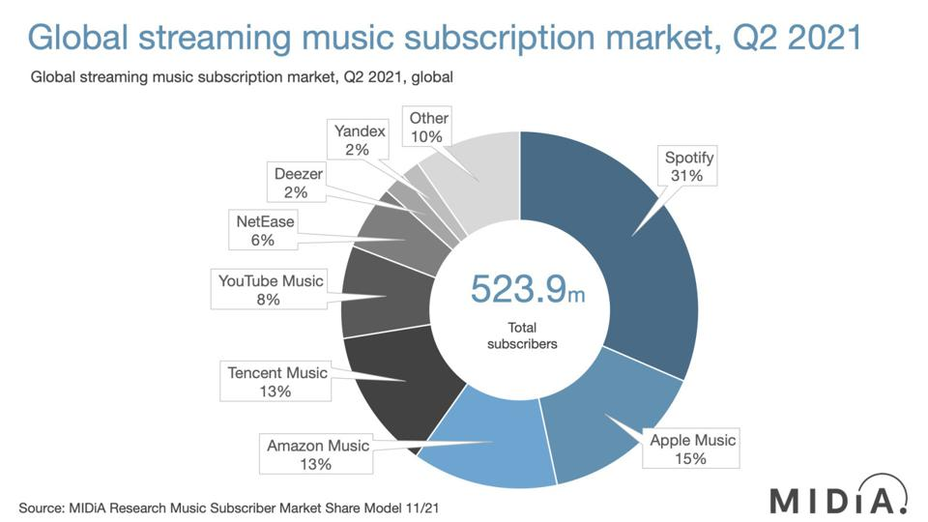
Notes:
Source: Forbes
https://www.forbes.com/sites/eamonnforde/2022/01/19/spotify-comfortably-remains-the-biggest-streaming-service-despite-its-market-share-being-eaten-into/?sh=6f71a5134743

Slide 3

TOP Hit Prediction
Applied Data Science

Slide 4
Scope – Use CASe
Music plays a significant role in our lives, and with the rise of digital music platforms like Spotify, it has become easier than ever to access and discover new music
Notes:
Introduction to use case, goal, selection of data set
Start:
How many of you have a Music Streaming Subscription?
As a Service Provider
Would you like to know whether a song will be a Hit before you release it?

Slide 5
Scope
Identify Possible top hits based on song features
Useful for music streaming platforms, record labels & artists
Make informed decisions about their music releases and marketing strategies.
Understanding of relationship between song features and popularity
Provide valuable insights that can help shape the future of the music industry.
Perform exploratory data analysis
Select the relevant features
Build a machine learning model to predict the popularity of songs & evaluate its performance
Notes:
Introduction to use case, goal, selection of data set

Slide 6

Scope – Selection Data Set
Objective Features provided by Spotify API “1.2 Million Songs Data”
Charts Data by “Spotify tracks chart dataset (2014-2022)”
The datasets are "Top Hits Spotify from 2000-2019" by Paradisejoy
"Spotify 12M Songs" by Rodolfo Figueroa, and "Spotify Chart Data" by J Freyberg.
Notes:
Clarify BASE Data Sets!

Slide 7
Scope – Spotify API FEATURES
NAME | Description
Popularity | Measurement: Derived from absolute & recent number of streams
Energy | Liveliness of the song
Loudness | Derived from decibel measurements of the song
Liveness | Degree to which the song sounds like it was record live vs. studio produced
Danceability | Measurement of how easy it is to dance to the song
Speechiness | Measurement of words spoken
Instrumentalness | Measurement of instrumental sounds within the song
Valence | Measurement of the positivity of the song
Mode | Indication of modality (major or minor)
Excplicit | Indication whether the song contains swear words (yes or no)
Key | Standard pitch class notation (C to H)

Slide 8

Domain Exploration – Hit Song Science
Area first defined by Mike McCready in 2002 (CEO of Polyphonic)
Goal/Business Model:
Evaluate Hits before they are released
Identify & match musical preferences of certain groups
Original Procedure: Analyze mathematical structure of rhythm, changes in key & melodic pattern
Notes:
Brief literature review about domain and previous data science projects in this domain
Sources:
Ruth Dhanaraj; Beth Logan (2005) „AUTOMATIC PREDICTION OF HIT SONGS”
Internet → Web Archive 2005:
https://hitsongscience.com/
http://www.polyphonichmi.com/about_us.php

Slide 9
Domain Exploration – Previous Data Science Projects
Goals | Input | Features | Methods | Result
Predict Song Popularity (>90%) | Spotify Developer Application Programming Interface | Explicitness, Instrumentals, Danceability | KNN, Random Forest, Gradient Boosted Trees, Logistic Regr. | Max. 72% Accuracy
Predict Hit in Billboard Hot 100 | Million Song Data Set (MSD), Spotify API (Extra) | All API Features & Artist Score (Custom) & Release Time | EM, LR, GDA, SVM, DT and NN (RF) | 69 - 77% Accuracy (81 – 89% Accuracy)
Determine Variation of Attributes to Streams | Spotify API (Custom Python Code) | Genre (SF) & All API Features | Correlation Analysis, Linear Regression | Low Explanatory Power
Determine Variation of Attributes to Popularity | Spotify WEB API (Custom Code) ONE Artist | All API Features | Beta regression model, GLMM, Beta GLMM | Mixed Explanatory Power (some Pos, some neg, rest irrelev)
Determine Features of Successful Playlists | Spotify & Surveys |  | Plotting | Intimacy, Focus & Variety
Characterize Trendy Music Clusters | Spotify API | All API Features | KNN | Variety of Size & Attributes
Notes:
Sources:
L1: Dawson, Christopher E. Jr.; Mann, Steve; Roske, Edward; and Vasseur, Gauthier (2021) "Spotify: You have a Hit!," SMU Data Science Review: Vol. 5: No. 3, Article 9.
L2: Georgieva, Elena; Suta Marcella; Burton, Nicholas: “HITPREDICT: PREDICTING HIT SONGS USING SPOTIFY DATA” (2018)
L2,5: Middlebrook, Kai; Sheik, Kian: „SONG HIT PREDICTION: PREDICTING BILLBOARD HITS USING SPOTIFY DATA “ (2019)
L3: Nijkamp, Rutger “Prediction of product success: explaining song popularity by audio features from Spotify data” (2018)
L4: Spera, Carola; Sciandra, Marangela “A Model Based Approach to Spotify Data Analysis: A Beta GLMM” (2020)
L5: George John Jordan Thomas Aquinas Hayward „What makes a playlist succesful? “ (https://ghayward.github.io/assets/files/Data_Scientist_Presentation_George_JJTA_Hayward.pdf)
L6: http://www.na-businesspress.com/JMDC/JMDC14-3/8_Al-BeitawiFinal.pdf
TBD: Methoden + Datensätze + Selected Features
Abkürzungen:
Expectation Maximization (EM), Logistic Regression (LR), Gaussian Discriminant Analysis (GDA), Support Vector Machines (SVM), Decision Trees (DT), and Neural Networks (NN)
Random Forest (RF)
Generalized Linear Mixed Models (GLMM)
All API Features:
Danceability, Energy, Speechiness, Acousticness, Instrumentalness, Liveness, Valence, Loudness, and Tempo
Duration, Mode

Slide 10

Domain Exploration
GO for Use Case
Confirmation of Data Base
Limitations:
Bias due to Spotify API
Limited to Data Base Info e.g. No Genre
No Details of Calculation
Excludes Soft Factors

Slide 11
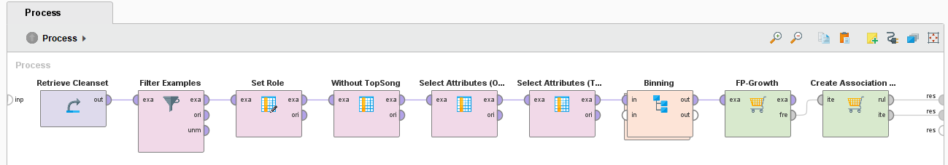
Modeling: FP Growth – Process General
Frequent Item Combinations – Very Lean Process
Result: „If x then y“
Requirement: Need to convert features from quantitave to categorial
Bias: No direct comparision between „Top Song“ & „No Top Song“

Slide 12
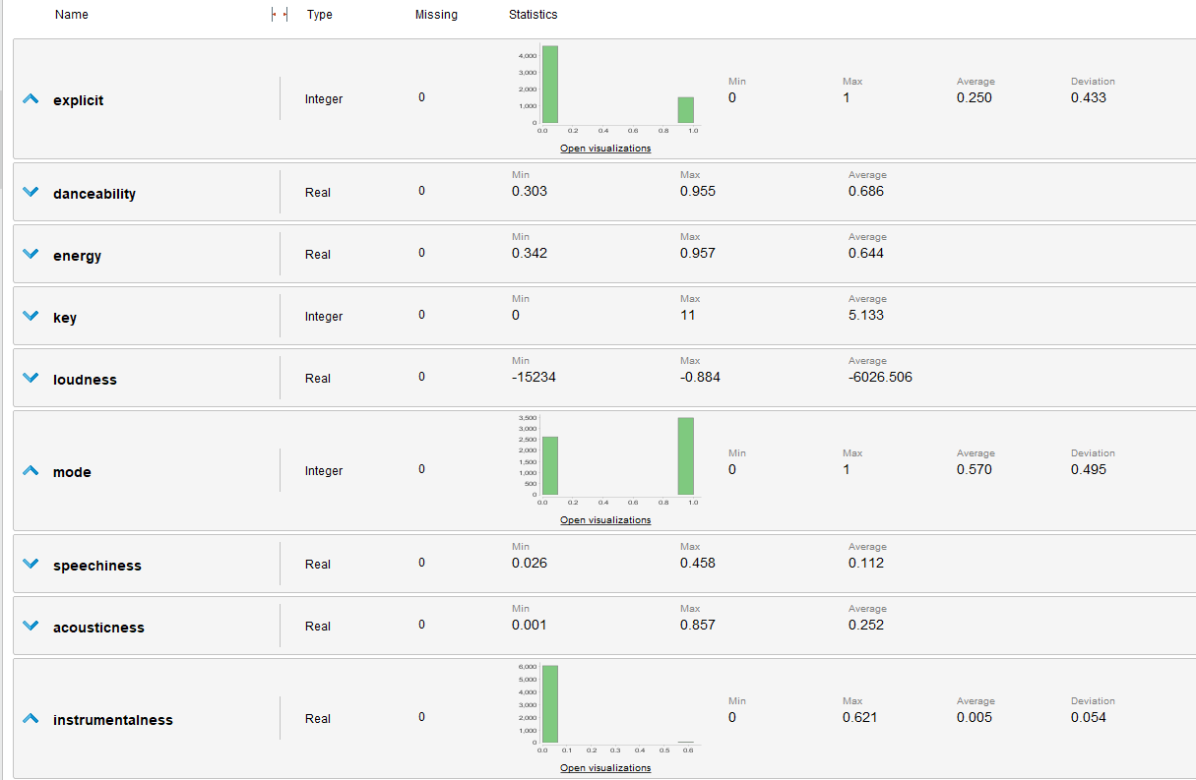
Modeling: FP Growth – Imbalanced Attributes

Slide 13
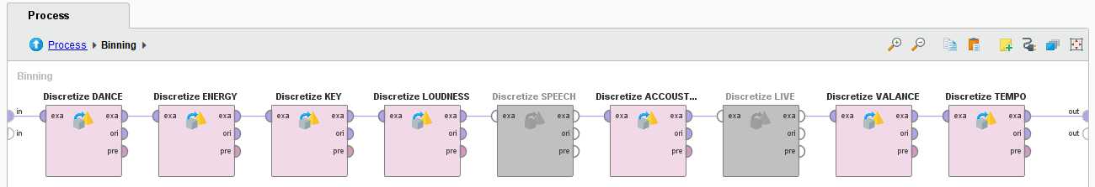
Modeling: FP Growth – Process Binning
Customized Binning
Advantage: Range adapted to the scale & classes directly readable
Disadvantage: High Manual Effort – To be adjusted with every change

Slide 14
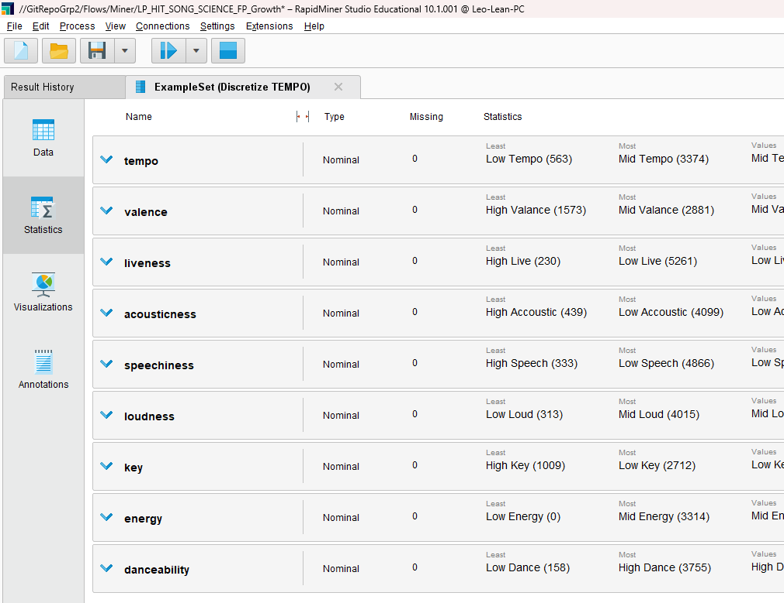
Modeling: FP Growth – Binning Result

Slide 15
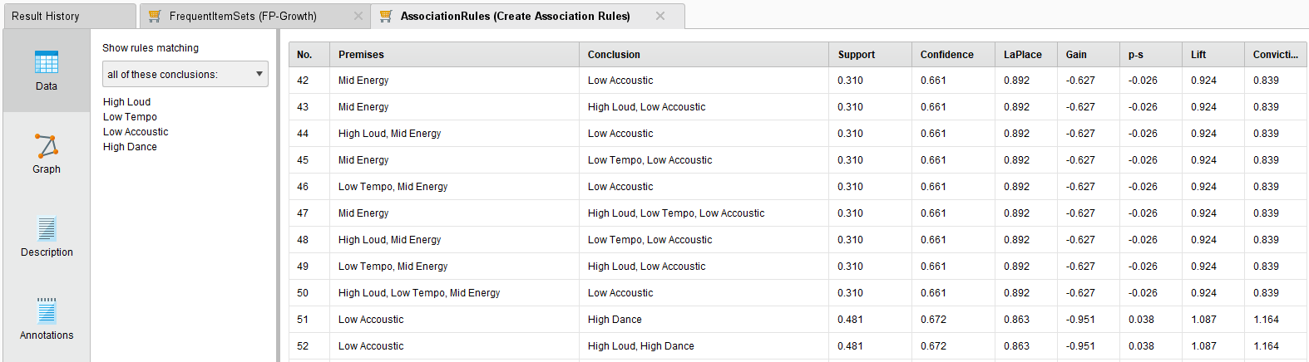
Modeling: FP Growth – Result “TRUE”

Slide 16
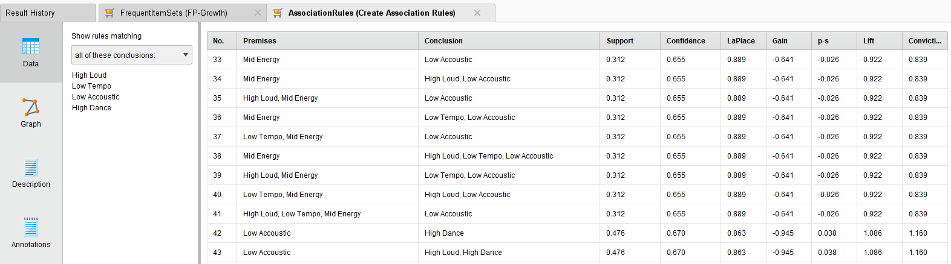
Modeling: FP Growth – Result “FALSE”

Slide 17
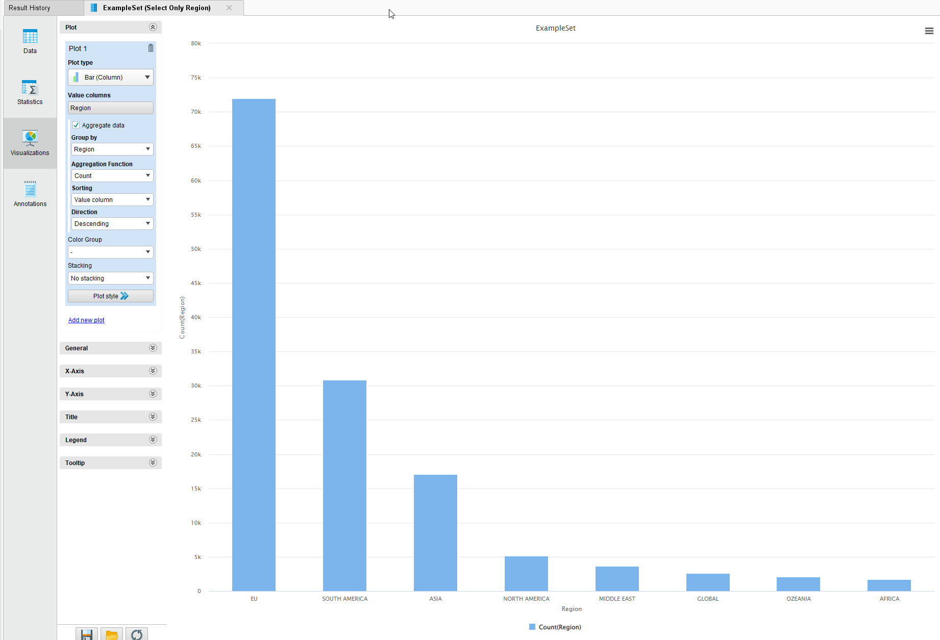
Modeling: REGION – DATA set
Notes:
Achsenbeschriftungen!

Slide 18
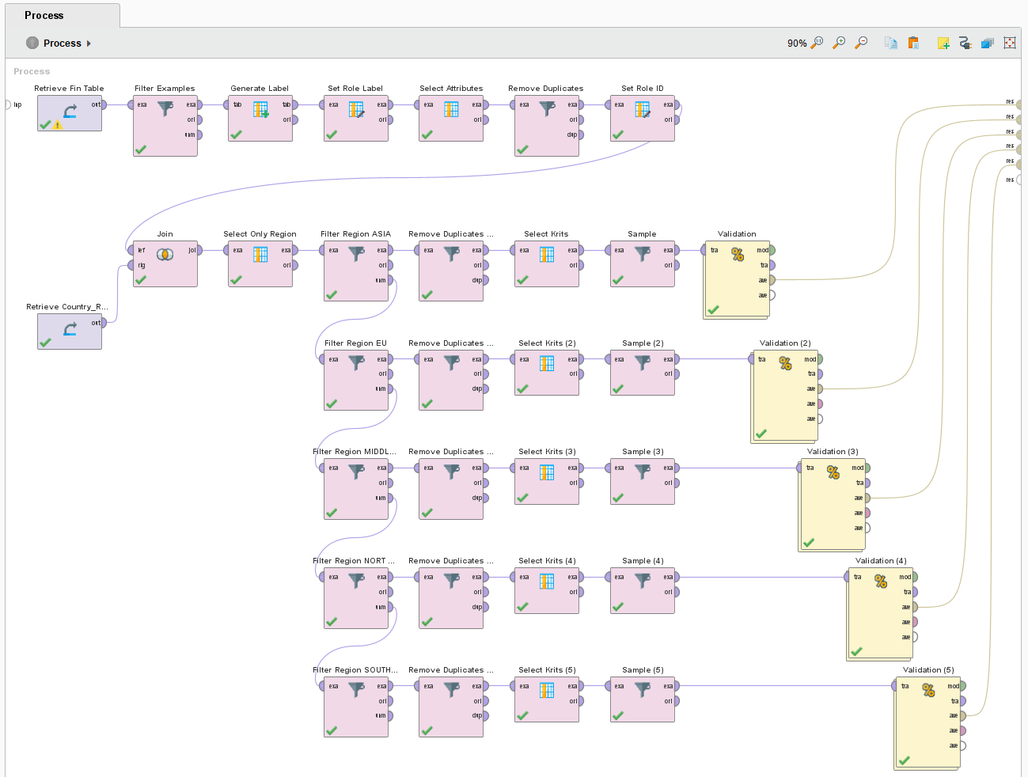
Modeling: REGION – Process General

Slide 19
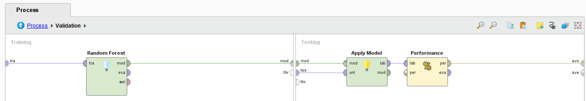
Modeling: REGION – Validation
Approach: Lean Process & Comparable Results
Highly Depends on available Datasets per Region
Room for further Investigations

Slide 20
Modeling: REGION – Result
Notes:
Recall Ergänzen!

